Slide 1
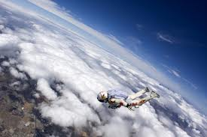
Felix Falls 24 Miles down to Earth!
By: Melanie Pieper

Slide 2
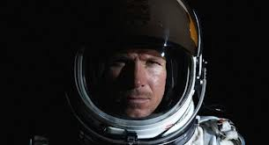
Felix Baumgartner
Austrian skydiver
Born the 20th of April 1969.
Attempted the highest sky-dive on record.

Slide 3
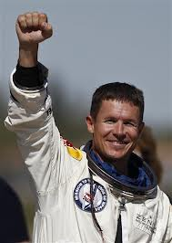
He Did It!
Felix Baumgartner broke speed of sound!
He jumped from an altitude of 128,097 feet and landed safely on the surface 9 minutes later!

Slide 4
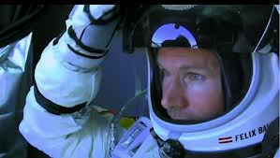
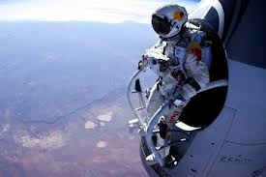
Broke Multiple Records!
He reached a high speed of 834 mph as he fell 119,846 feet during a free fall of 4 minutes and 20 seconds!

Slide 5
THE END!
Those thrilling 4 min. and 20 sec. of complete free fall made history for Felix Baumgartner!

